Slide 1
Bodies
Dr. Jacob Moore
Associate Professor of Engineering
Penn State Mont Alto

Slide 2
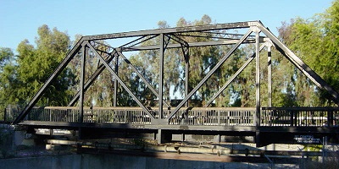
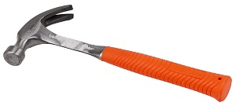

Bodies
What is a body?
A body is any object or collection of connected objects that we want analyze as a whole.

Slide 3
Types of Bodies
A body is a very general term, but we will often want to start by making some assumptions about the body we are analyzing.
The two most important distinctions will be…
Will I treat this as a rigid or deformable body?
Will I treat this as a particle or an extended body?

Slide 4
Rigid vs. Deformable
A rigid body is a body which does not bend, stretch, twist, or otherwise deform in any way under loading.
A deformable body is a body which will bend, stretch, twist or otherwise deform under loading.
In actuality, every body is deformable, but sometimes the deformations are small enough we will ignore them.

Slide 5
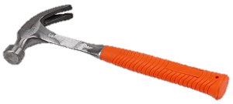
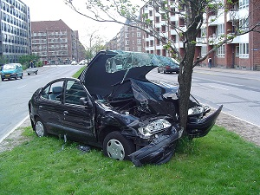


Rigid vs. Deformable Examples
Rigid Bodies
Deformable Bodies

Slide 6
Particle vs. Extended Body
A particle, is a body where we assume all the mass is concentrated at a single point.
An extended body is any body where the mass is spread out over an area or volume.
In actuality, every body is an extended body, however we can treat a body as a particle in some cases to simplify problems

Slide 7




Particle vs. Extended Body Examples
Particles
Extended Bodies

Slide 8
Notation Shorthand
In statics and dynamics, we will almost always assume we are working with rigid bodies.
Strength of materials is the study of deformable bodies
In statics and dynamics then we will work with particles, and we will work with rigid, extended bodies.
Often when discussing a rigid, extended body in mechanics we will simply call it a rigid body.

Slide 9
Thanks for Watching
See other engineering mechanics videos and access the full tool at…

